Slide 1
What is an OLAP cube?
On-Line Analytical Processing (OLAP) is a way to organize data to fit the way users analyze it — in hierarchical categories and precalculated summary values.
An OLAP cube provides only the summarized results to your reports, instead of a large number of individual records, so that you can analyze a larger amount of data than your system's resources could otherwise handle.
When you create an OLAP cube from data in a relational database, you perform the initial steps of creating the reports that you or your users need.

Slide 2
Creating OLAP cube in Excel
Create an OLAP cube when you want to work with a large amount of external data in your reports, especially if you have more records to analyze than you can return to Excel without running out of system resources.
Because a cube allows Excel to retrieve only the data it needs for the current view of the report, creating and updating a report is usually faster for large amounts of data than if you retrieved the entire set of records from the database.
The data from your OLAP cube can be returned to Excel only as a PivotTable or PivotChart report, unlike the relational database records in your query, which can also be returned to Excel as an external data range on a worksheet.

Slide 3
MS Query -> OLAP Cube Wizard
The wizard lets you create two types of cubes.
  One type is a cube definition that the wizard saves in an .oqy file. When you open a report that's based on this type of .oqy file, the cube is built temporarily in memory.
  The second type is a separate offline cube file that you store on your local disk or a network share. If stored on your local disk, this file allows you to continue working with the data when you are disconnected from the network. You can set up an offline cube file as a data source for reports.

Slide 4
Changes in OLAP cube
After you create an OLAP cube in Microsoft Query, you cannot add more fields to it from the original relational database. You can, however, use the same query to create a new OLAP cube that includes different fields.
  save a database query (.dqy) file in Microsoft Query
  open the query file and run the OLAP Cube Wizard to create a new cube that includes additional fields from the original database

Slide 5
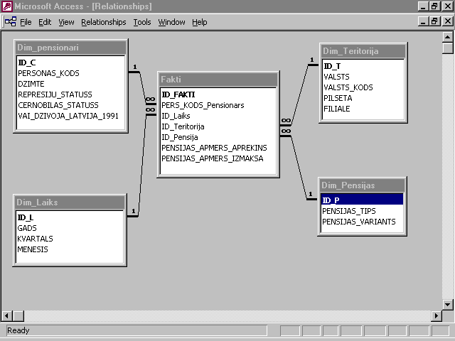
Datu noliktavas shēma

Slide 6
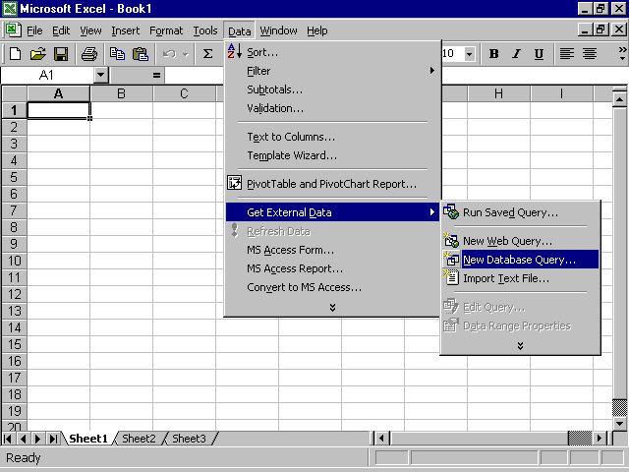
OLAP kuba veidošana ar Excel: 1.solis

Slide 7
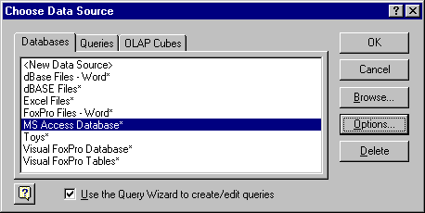
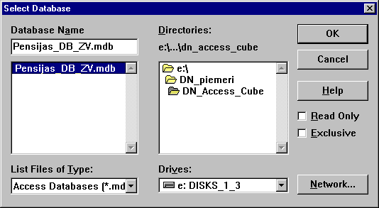
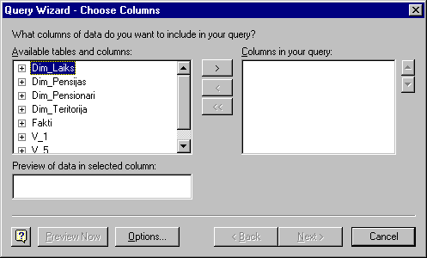

Slide 8
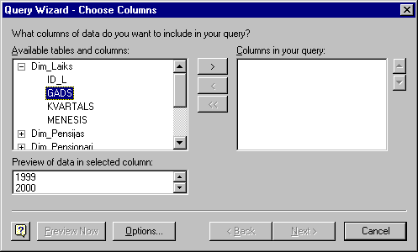
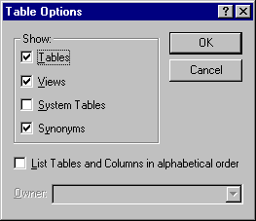
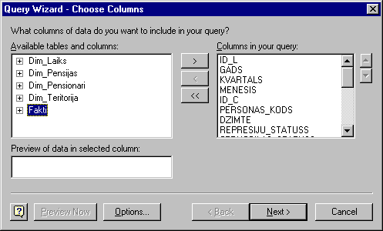

Slide 9
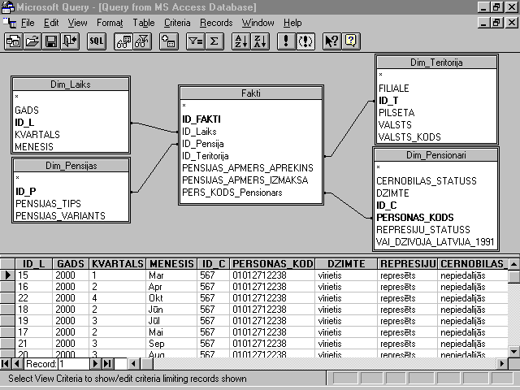

Slide 10
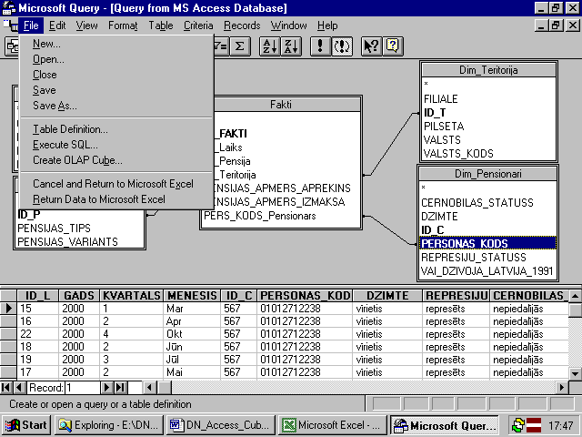
OLAP kuba veidošana ar Excel: 2.solis

Slide 11
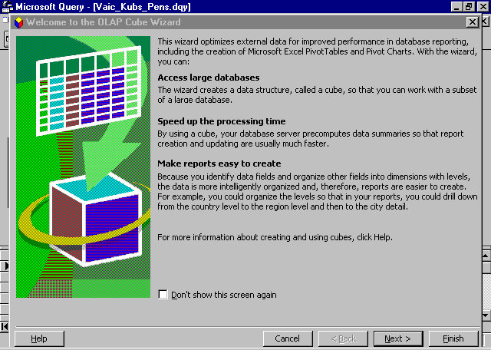

Slide 12
OLAP Cube Wizard
This wizard steps you through the process of organizing external data you've selected in a query into an OLAP cube, which is a way of organizing summarized data for analysis.
The wizard creates a database report, in a form of PivotTable or PivotChart report.
When you finish the wizard, you will have a cube on which you can base reports. After you create and view reports, if you find that you want to organize the cube differently or include different data in it, you can return to this wizard to make changes.

Slide 13
Data fields and dimensions
The wizard lets you take a flat series of records, apply a hierarchical organization to the fields, and define the summary values you want to calculate.
The resulting cube contains two types of data:
  summarized values, such as the number of items sold, are called data fields.
  descriptive facts about these values, such as the date and location of each sale, are organized into levels of detail called dimensions.
When you organize the fields, you can use the same kinds of categories that you or your users employ when you analyze the data in reports. Data fields and dimensions make it easy for reports to display high-level summaries, such as sales totals across an entire country or region, and also display the lower-level details, such as sites where sales are particularly strong or weak.

Slide 14
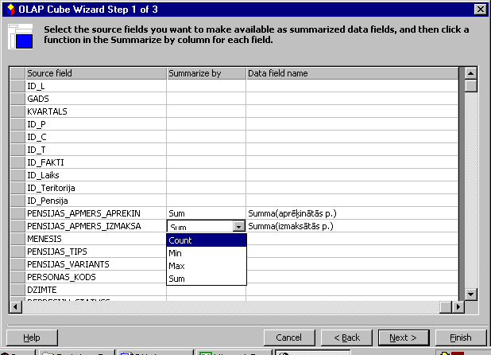

Slide 15
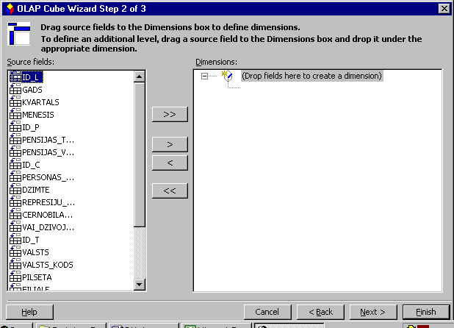

Slide 16
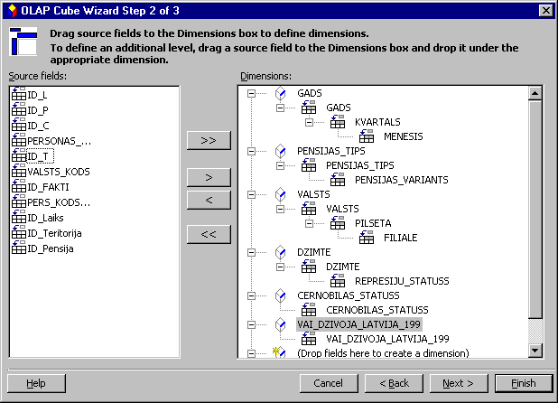

Slide 17
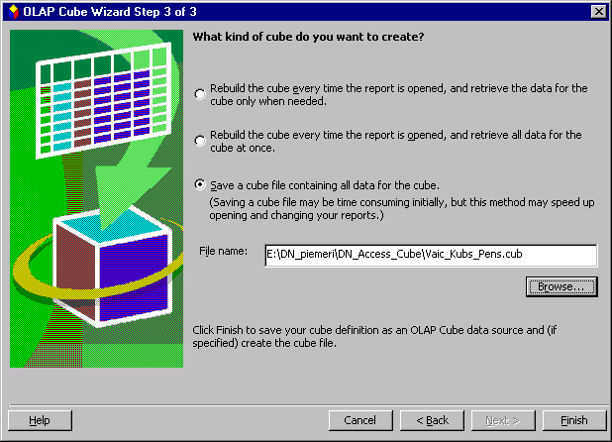

Slide 18
OLAP Cube Wizard: Step 3
Option 1: Retrieving data on demand
  stores instructions for creating the cube along with your query or report, and creates the cube itself only when you open the report. The cube initially retrieves only the data that's needed to display the report, and it retrieves more data as needed when you change what the report displays.

Slide 19
Option 2: Retrieving all data at once
  stores instructions for creating the cube along with your query or report, and creates the cube itself only when you open the report.
  the cube retrieves all of the data for the report at one time, when you first open the report, so that you can change what the report displays without waiting for the cube to retrieve more data.
Option 3: Saving a cube file
  creates a separate cube file on disk, retrieving all of the data for the cube and storing it in this file.

Slide 20
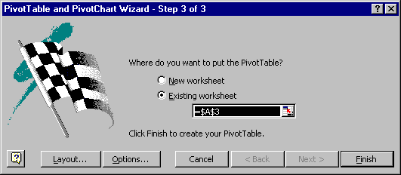
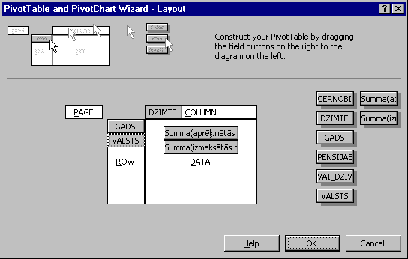
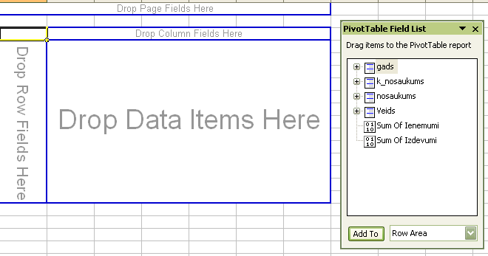

Slide 22
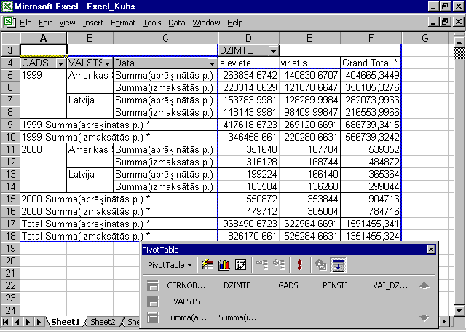

Slide 23
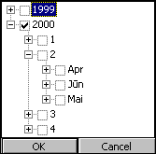
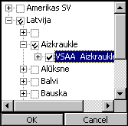
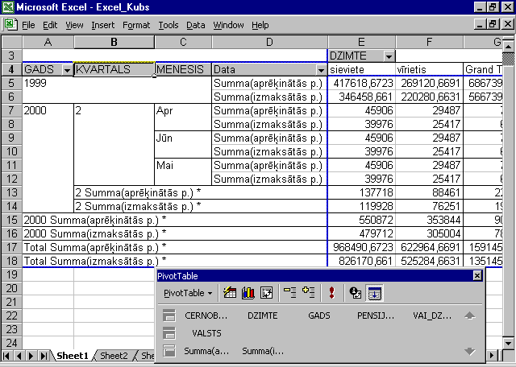

Slide 24
Disadvantages of data warehouses
Over their life, data warehouses can have high costs. The data warehouse is usually not static. Maintenance costs are high.
Data warehouses can get outdated relatively quickly. There is a cost of delivering suboptimal information to the organization.
There is often a fine line between data warehouses and operational systems. Duplicate, expensive functionality may be developed. Or, functionality may be developed in the data warehouse that, in retrospect, should have been developed in the operational systems and vice versa.

